Slide 1
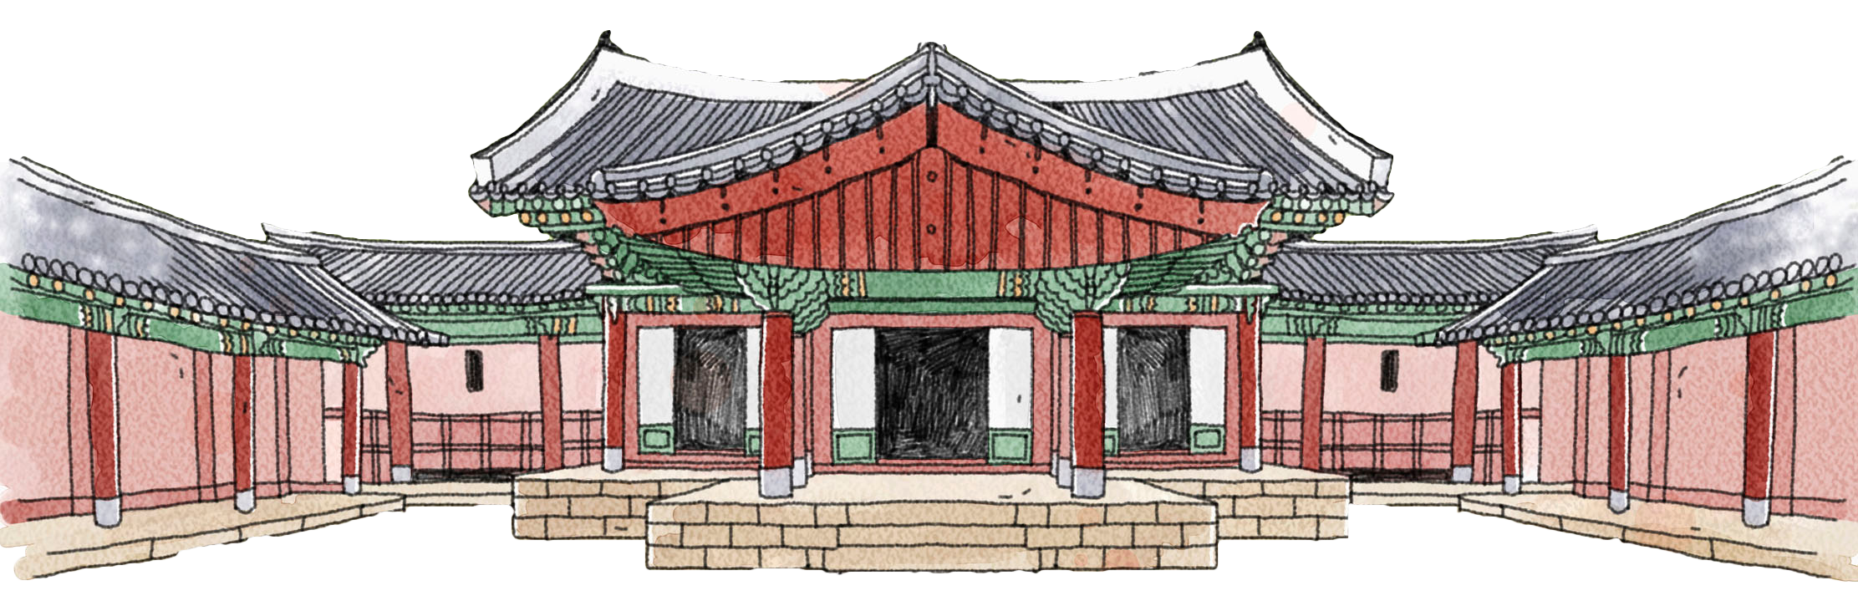
The features of traditional Chinese architecture

Slide 2
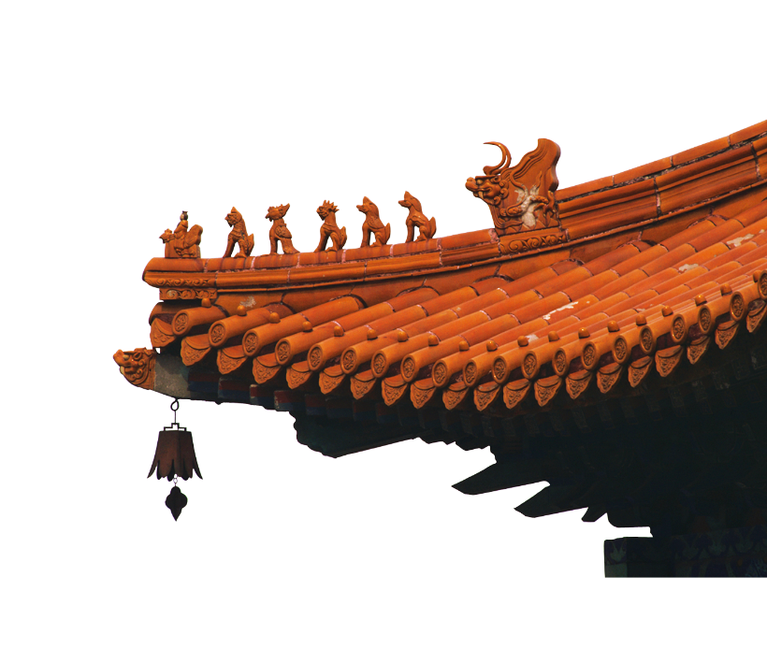

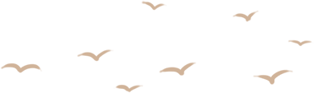
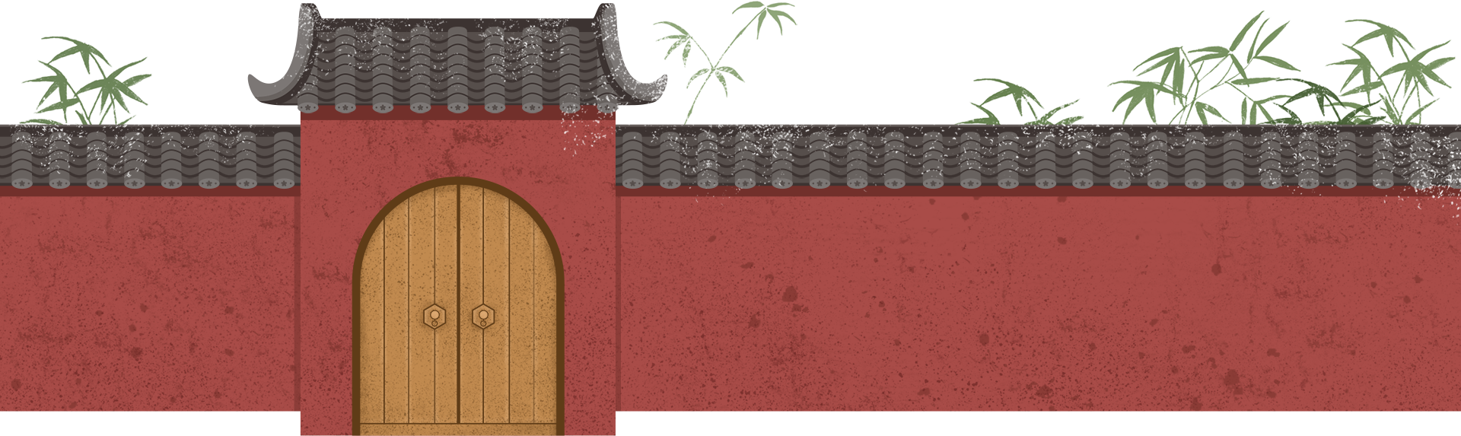
Overall
features
立体构成
WHOLE
平面布局
Contents
Structural features
木材结构
Structural method
斗拱
举折和举架
LOCAL
屋顶的装饰作用
大胆着色
Decoration features
部件的装饰作用
材料的装饰作用

Slide 3
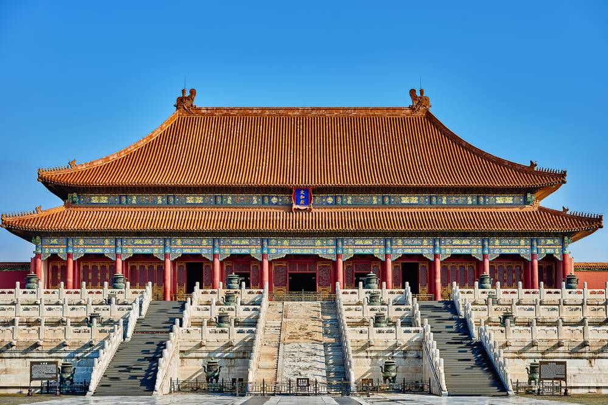
1 The three-dimensional composition of individual buildings.
roof屋顶
house房屋
foundation台基

Slide 4
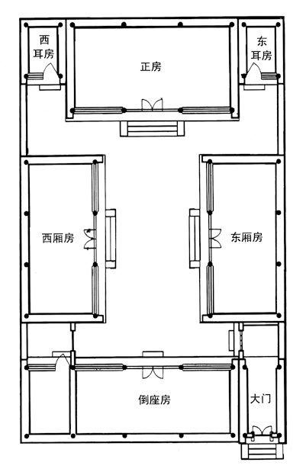
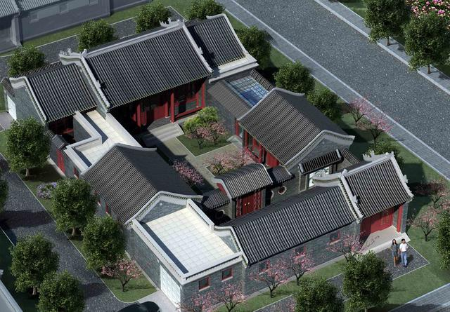
2 The layout of group buildings
Siheyuan 四合院
main house
ear room
ear room
wing room
wing room
Rear room

Slide 5
2 The layout of group buildings
main house
Main House: The main house is where the head of the family and their immediate family members live, typically containing the living room and main bedrooms.
Wing Rooms: Their functions vary; they might be used as bedrooms for children or guests, as storage spaces, or as work areas.
Ear Rooms: These rooms are usually smaller and serve more flexible, often more private purposes, such as studies, storage rooms, or servant quarters.
Rear House: Its uses might include kitchens, bathrooms, or other secondary living spaces.
This layout not only ensures the privacy and security of the residence but also reflects the hierarchical family structure and cultural values of respecting elders prevalent in traditional Chinese society.
ear room
ear room
wing room
wing room

Slide 6
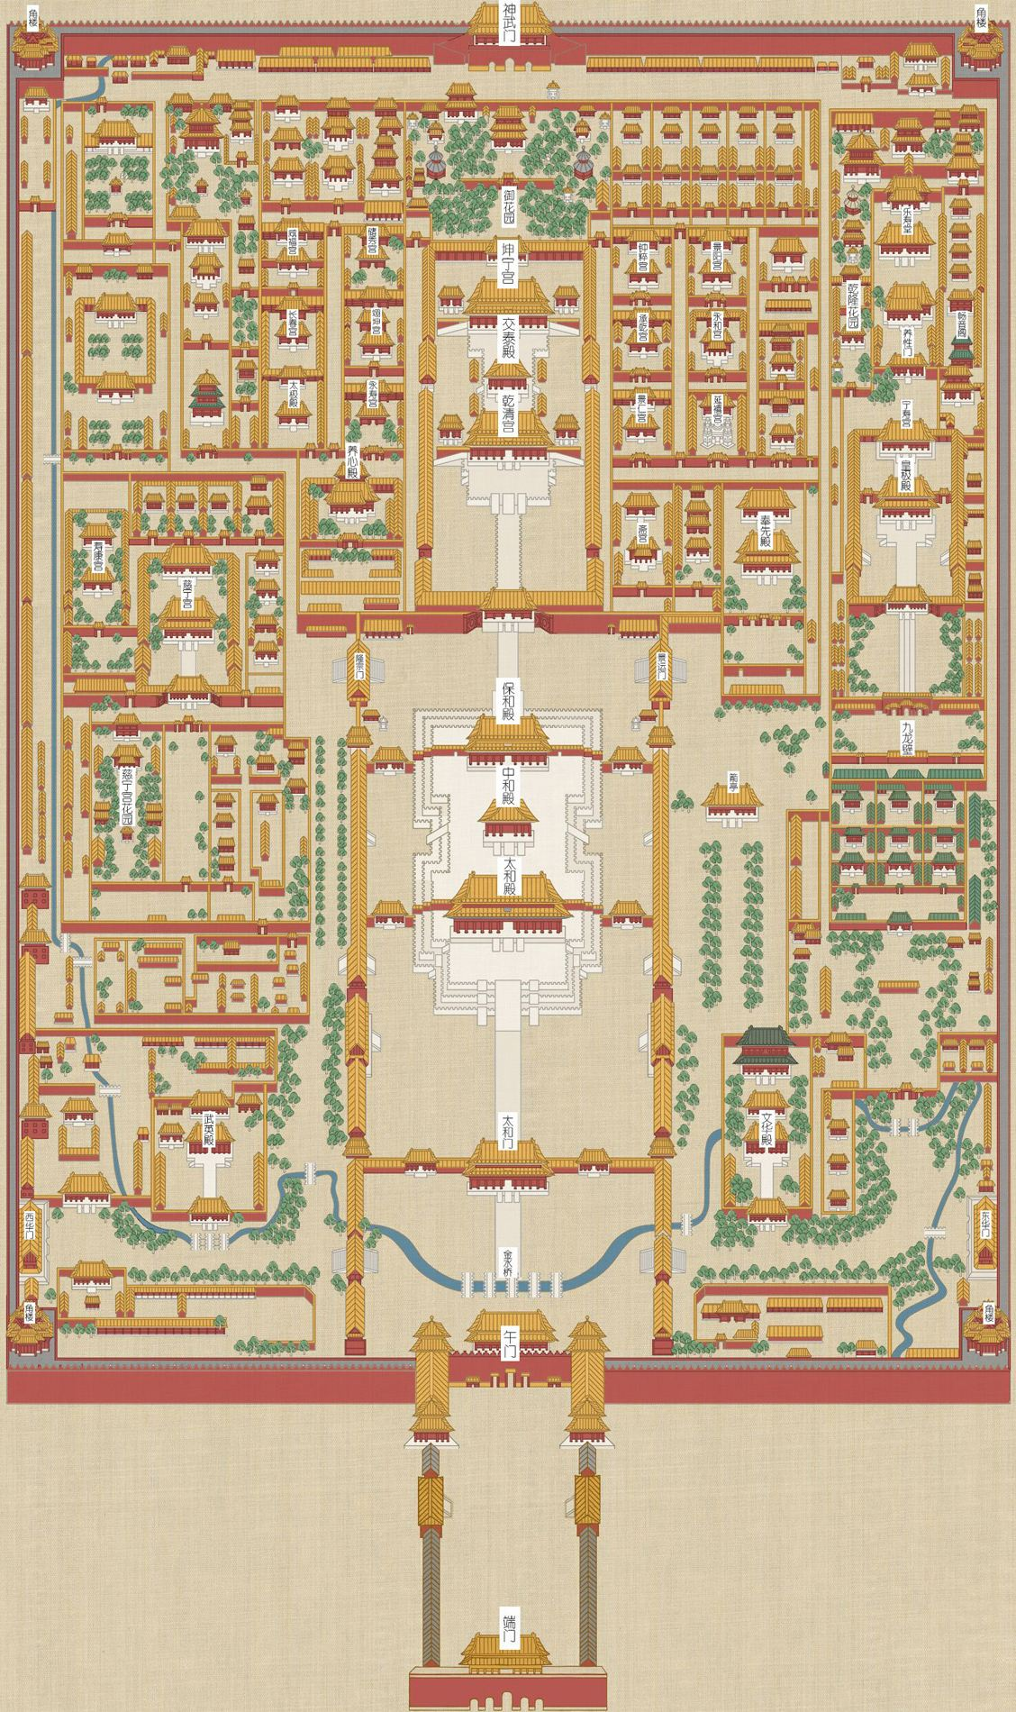
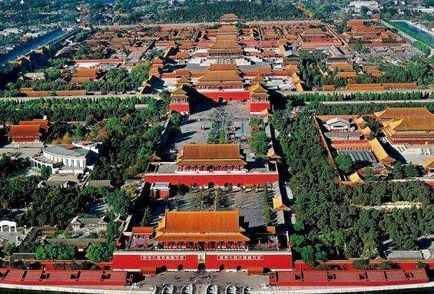
Most prominent feature：Axial symmetry

Slide 7
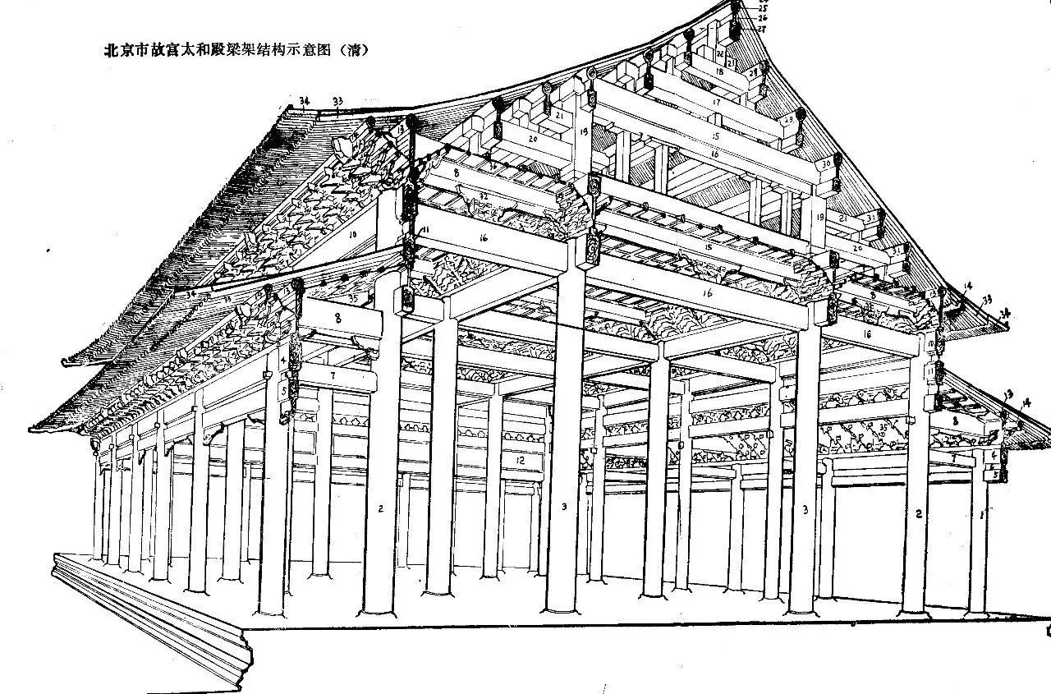
3 Primarily using timber as the structural method
column立柱
beam横梁
Load-bearing frame

Slide 8
3 Primarily using timber as the structural method
Column: Columns are vertical support elements, usually made of wood. They extend directly upwards from the ground to support the beams and roof structures above.
Beam: Beams are horizontal structural elements that span between columns to support the weight of the roof and upper floors.
Load-bearing Frame: A load-bearing frame is a framework composed of columns and beams.
In traditional architecture, this method showcases the beauty and practicality of wood, while also adhering to principles of natural harmony and design.
column立柱
beam横梁
Load-bearing frame
Beam
Column

Slide 9
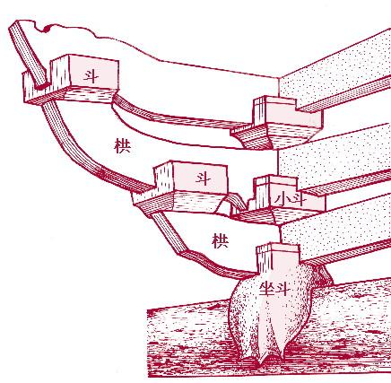
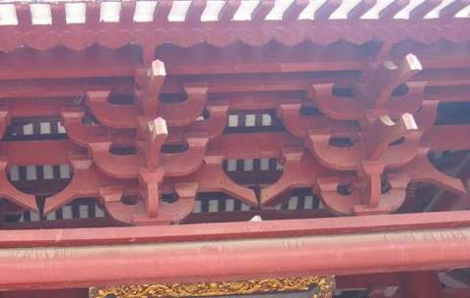
Dou Gong, is a distinctive architectural element in traditional Chinese architecture, commonly found at the corners of roofs and significant structural junctions.
Dou Gong consists of a series of interlocking wooden brackets, stacking one upon another to form a structure that serves both supportive and decorative purposes.
4 Dou Gong斗拱

Slide 10
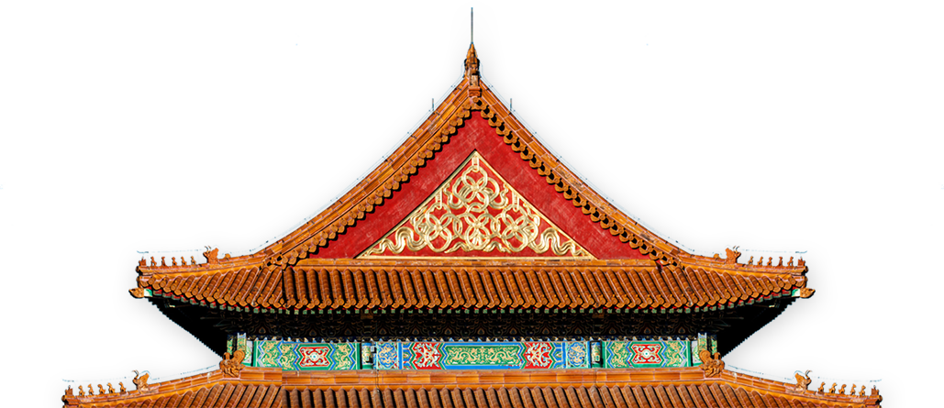
5 Juzhe/Jujia,
举折/举架 forming a sloped roof
In ancient China, the method for achieving a curved slope on roofs was referred to as "Juzhe" during the Song dynasty and "Jujia" during the Qing dynasty.
Both terms describe techniques that shaped roofs into curved surfaces, giving the rooftops of ancient Chinese architecture their distinctively beautiful curves, setting them apart from other architectural systems.

Slide 11
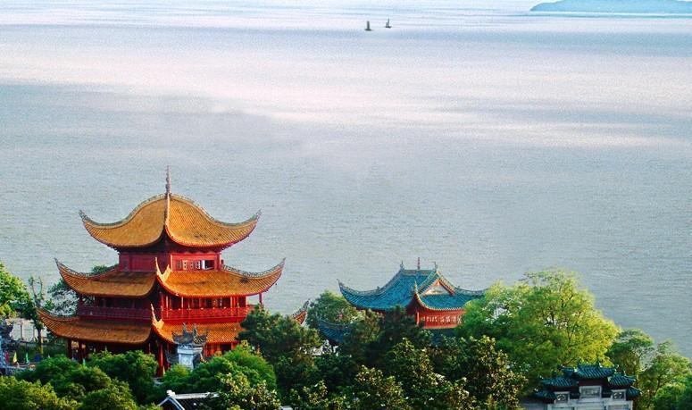
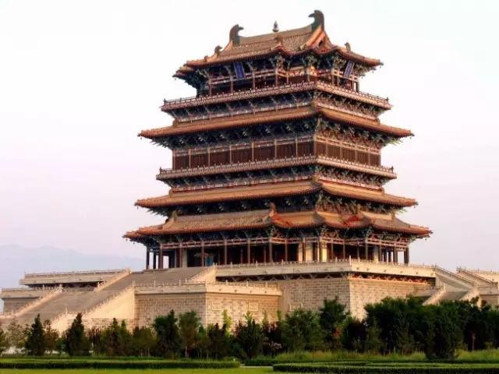
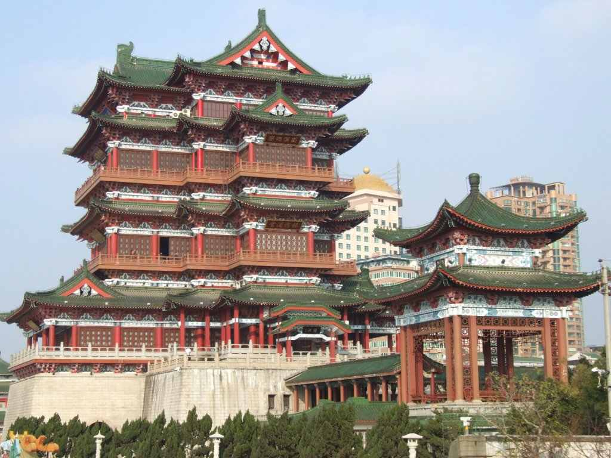
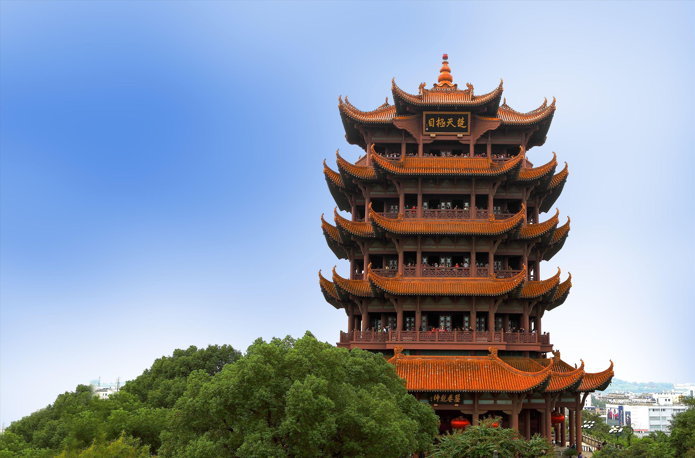
6 Decorative function of the roof
四角翘起，檐牙高啄
如鸟斯革，如翚斯飞
The corners rise up,
the eaves jut high like pecking.
Like birds stretching their wings, like hui soaring in flight.

Slide 12
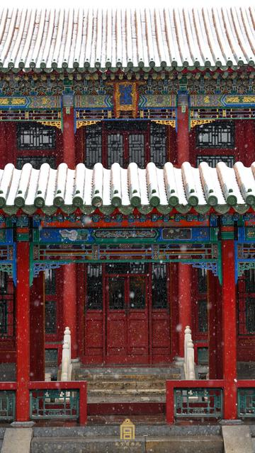
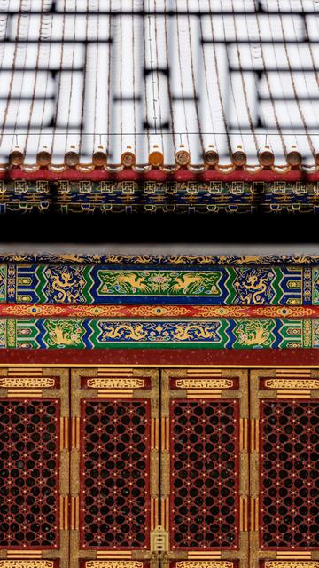
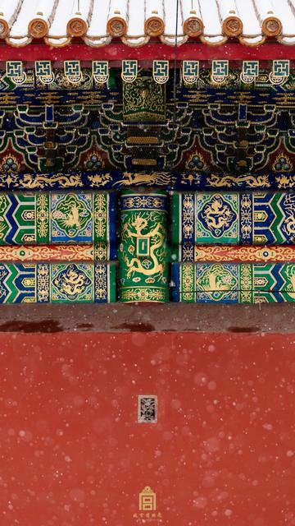
7、Bold coloring,
Vermilion and polychrome
大胆着色，朱红与彩绘

Slide 13
Bold coloring, especially vermilion and polychrome, is a key feature of traditional Chinese architecture's unique characteristic.
Vermilion, a deep red hue, is often used on columns, beams, and window frames of palaces, temples, and other significant structures, symbolizing auspiciousness and authority.
Polychrome typically appears on eaves, beams, and architectural brackets, showcasing intricate patterns and vibrant stories, enhancing the visual appeal of the buildings.
7、Bold coloring,
Vermilion and polychrome
大胆着色，朱红与彩绘

Slide 14
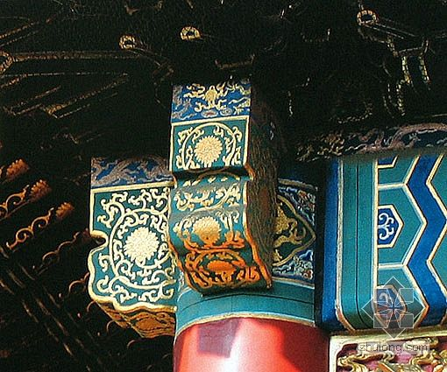
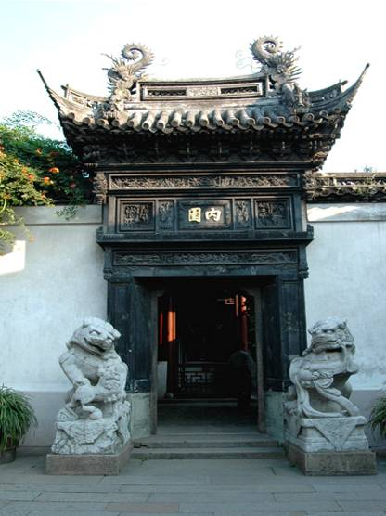
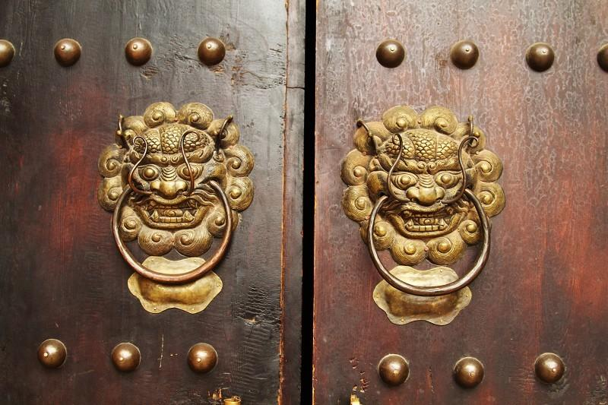
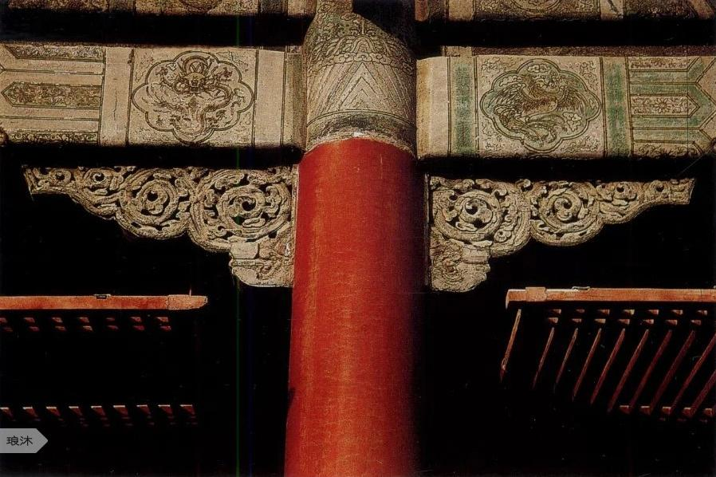
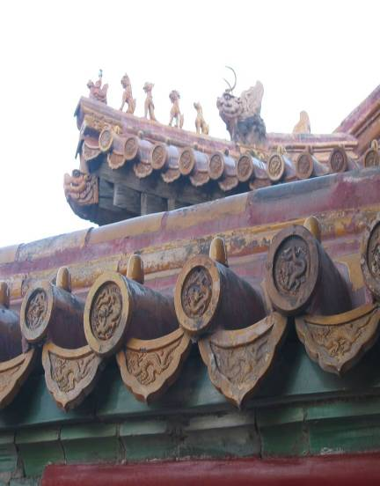
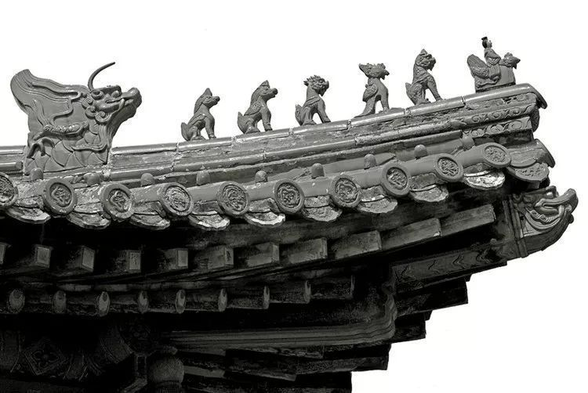
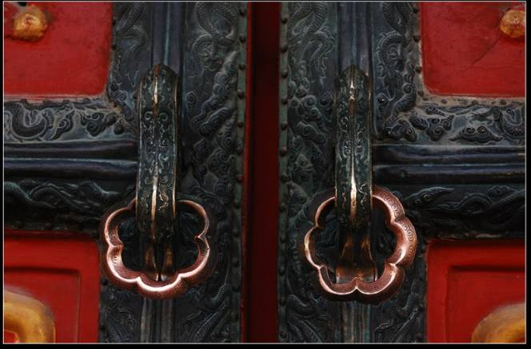
脊吻
瓦当
霸王拳
Door knockers
Ridge Beast垂脊吻
门环
三福云
8 Decorative function of components

Slide 15
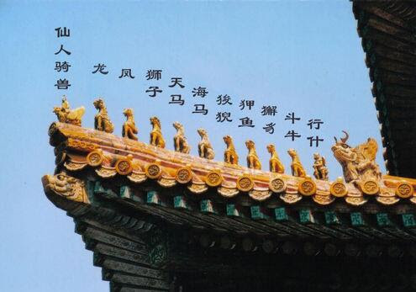
脊吻
霸王拳
Ridge Beast垂脊吻
8 Decorative function of components
Ridge beasts, are decorative sculptures located at the ends of the roof ridges in traditional Chinese architecture.
These sculptures come in various forms, typically depicting mythical creatures, and are believed to protect the house by warding off evil and ensuring safety.

Slide 16
Door knockers are typically installed on the doors of temples, palaces, official residences, and traditional homes.
They are usually made of bronze or other metals, and their surfaces may be gilded or silvered, often adorned with traditional auspicious patterns such as Loong, lions.
Door knockers serve a practical purpose. In times before doorbells, visitors would use them to alert those inside of their arrival. The sound of knocking with these traditional devices is often loud and melodious, imbued with a classical charm.
瓦当
Door knockers
门环
三福云
8 Decorative function of components

Slide 17
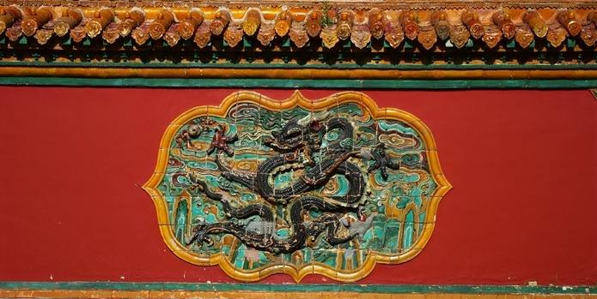
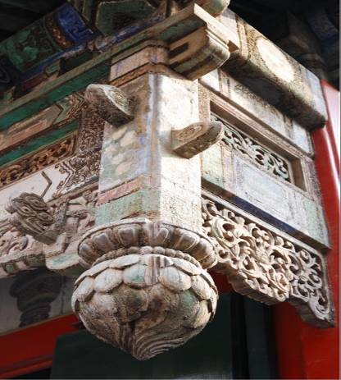
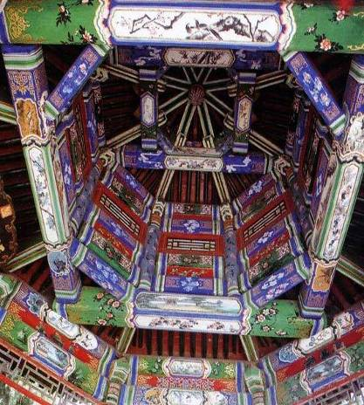
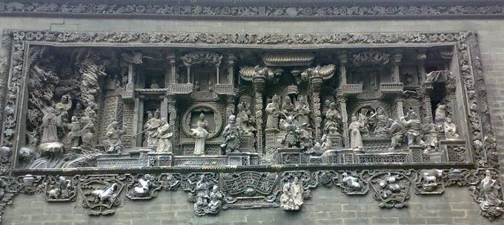
浮雕
木刻
彩漆
9 Decoration of building materials
琉璃
Glazed tile
They are colorful glazed ceramic tiles, typically used on the roofs of temples, palaces, and other significant buildings.
Glazed tiles are known for their vibrant colors and gloss, which reflect sunlight and make the architecture appear more magnificent and solemn.

Slide 18
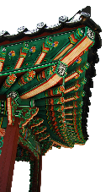
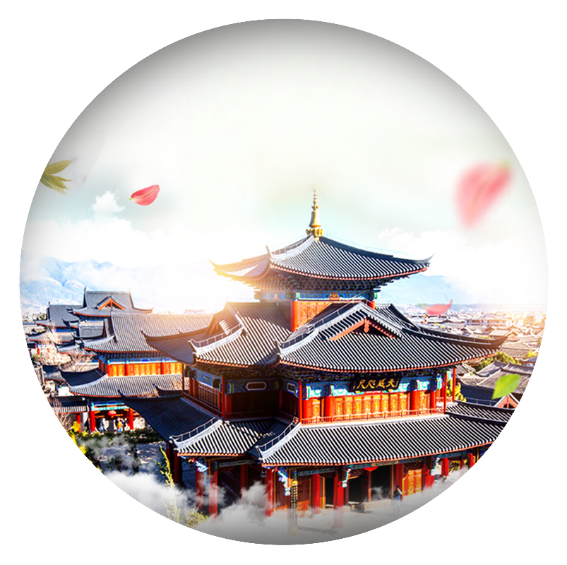
Summary
China's architectural system is a unique architectural system.
Space: widely distributed
Time: long history

Slide 19

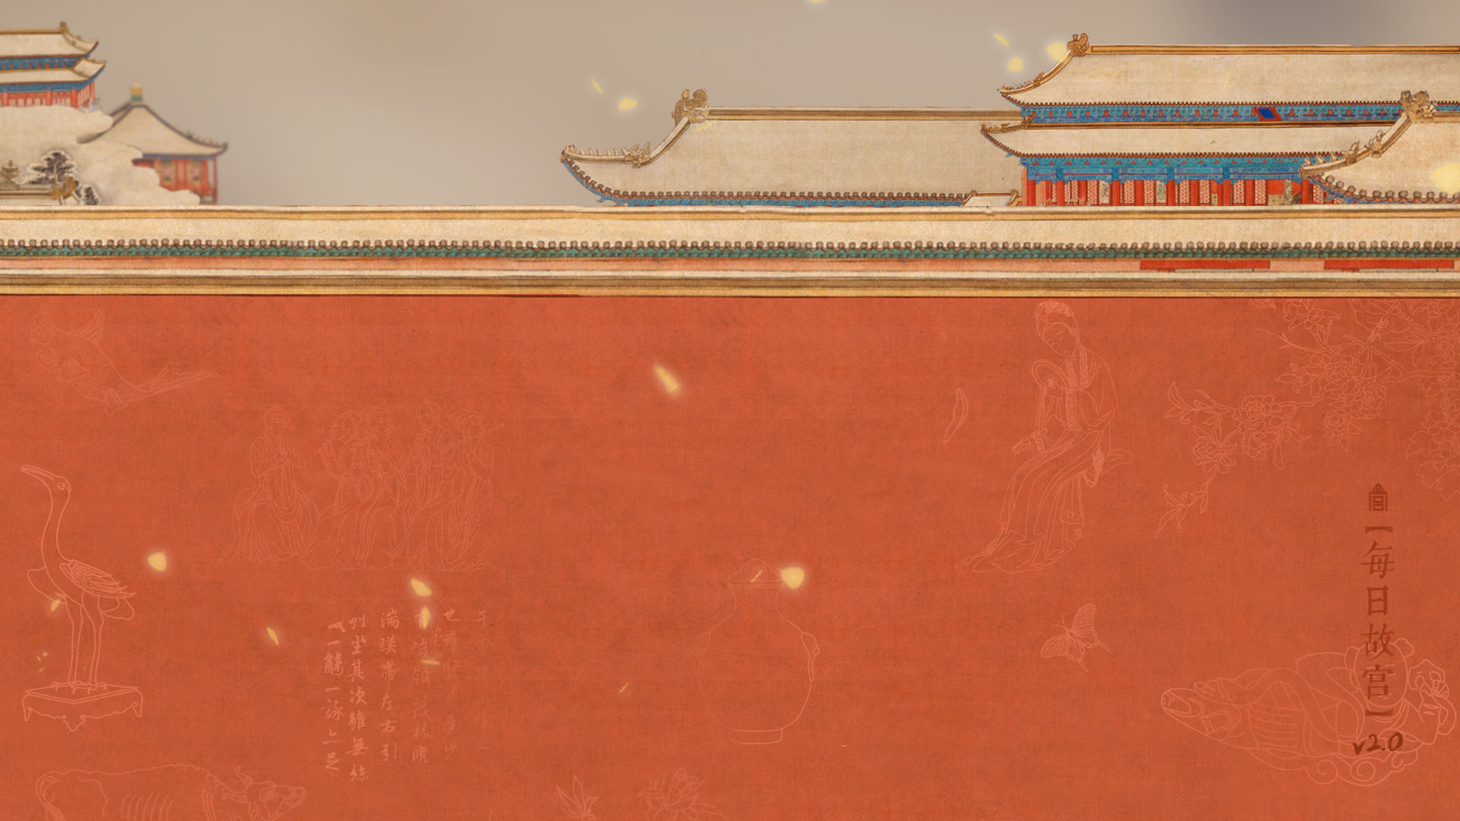

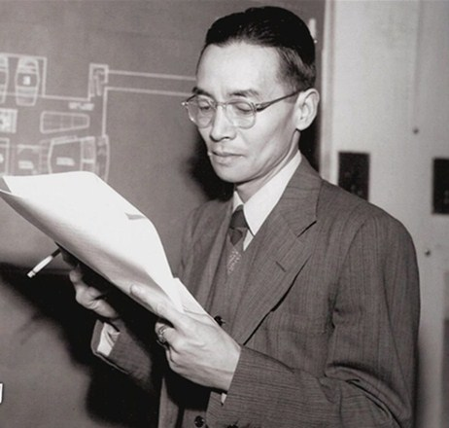
Reference
梁思成Liang Sicheng (1901-1972) was a renowned Chinese architect and a professor at Tsinghua University, originally from Xinhui County, Guangdong Province.
He earned his Master's degree in Architecture from the University of Pennsylvania in 1927 and later studied at the Graduate School of Design at Harvard University. He returned to China in 1928. In 1946, he founded the Department of Architecture at Tsinghua University and later led the establishment of the Society for the Study of Chinese Architecture.
His major works include "Building Standards of the Qing Dynasty" and "A History of Chinese Architecture."

Slide 20
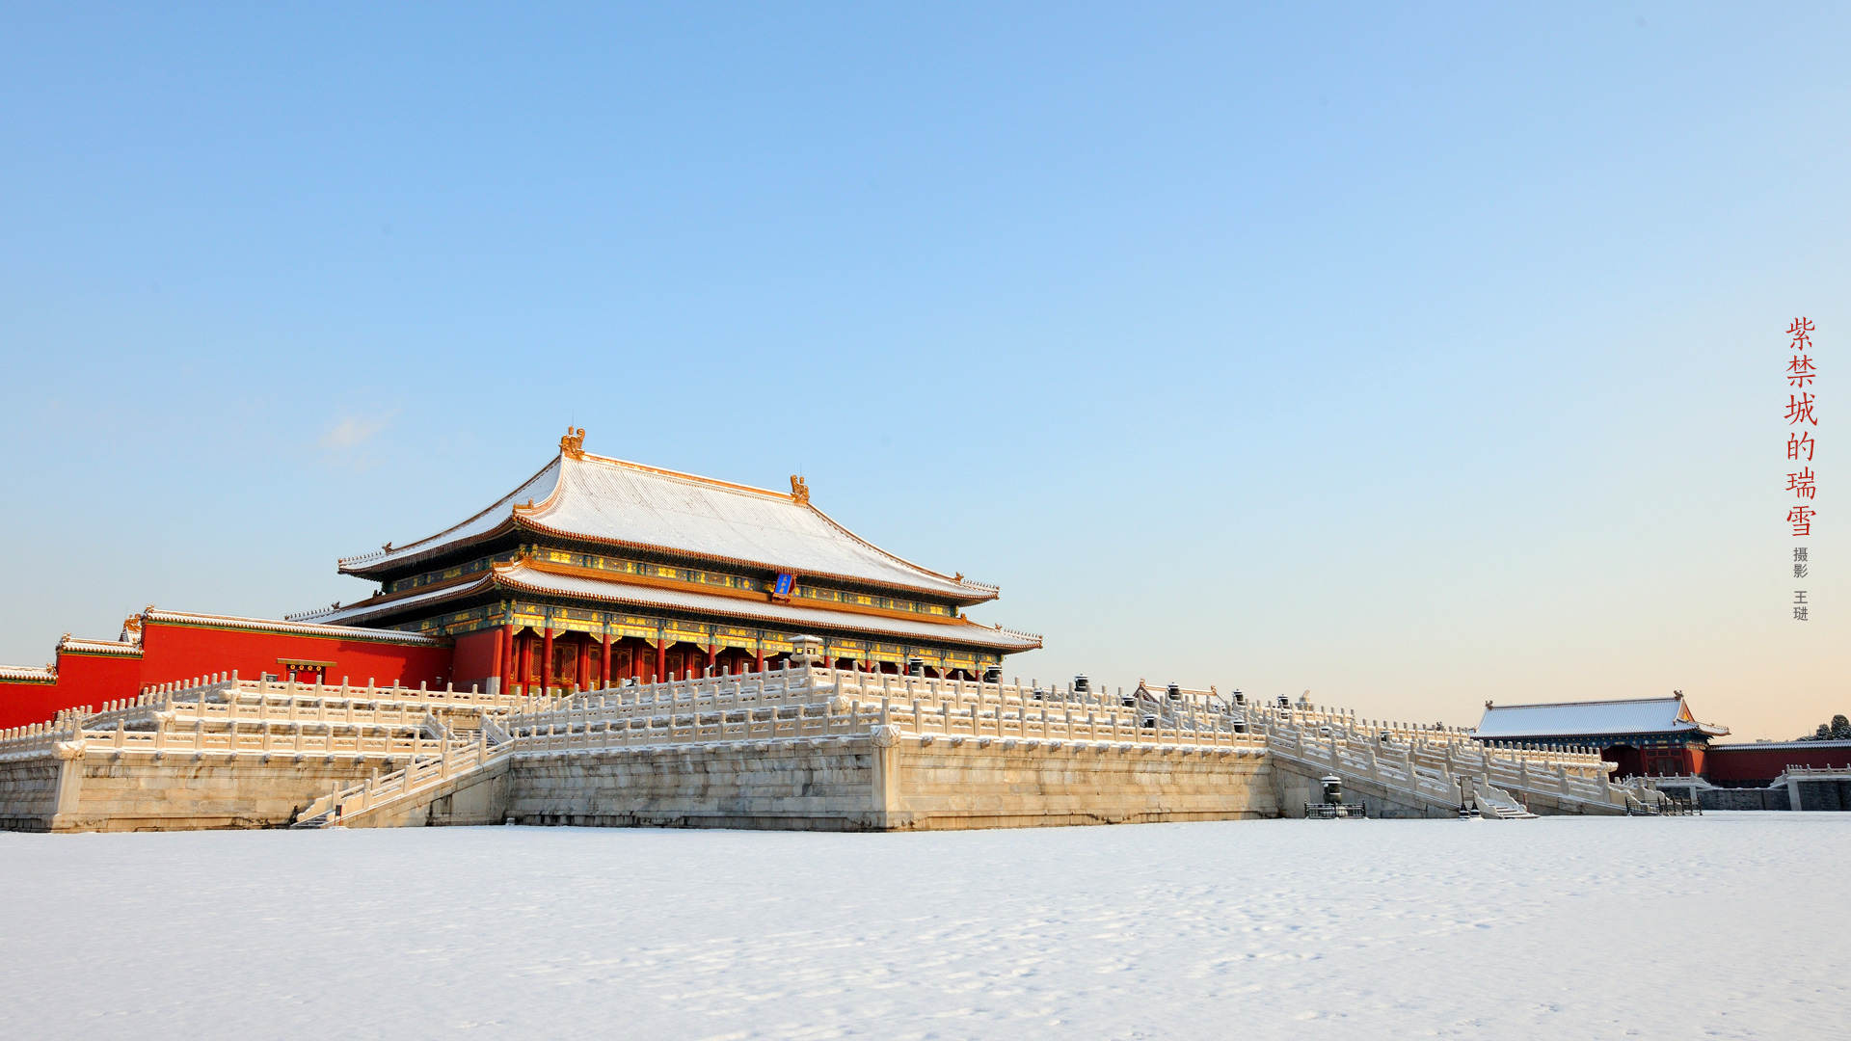
Since 1950, with the renovation of the old city and the construction of the subway in Beijing, ancient buildings began to disappear. Historical records show that in 1952, Changan Left Gate and Changan Right Gate were demolished. In 1954, Dianmen was demolished, followed by Chaoyangmen in 1956, Chongwenmen and Fuchengmen, Dongzhimen in 1965, and finally Xizhimen in 1969.
When the ancient Ming and Qing city walls were being demolished, Liang Sicheng and Lin Huiyin were seen caressing the bricks and weeping（抚砖痛哭）.

Slide 21
中国建筑的个性乃即我民族之性格。
一国一族之建筑是反鉴其物质精神、继往开来之面貌。
——梁思成《中国建筑史》
"The personality of Chinese architecture is indeed the character of our nation.The architecture of a country or a people reflects their material spirit and their development from the past to the future."
— Liang Sicheng, "A History of Chinese Architecture"

Slide 22
Through understanding ancient Chinese architecture, we are moved and amazed by the wisdom of the ancient Chinese people. Studying ancient architecture allows us to advocate for inheriting and promoting excellent traditions, applying the old to the new.

Slide 23
The features of traditional Chinese architecture
THANKS FOR WATCHING!

